Slide 1

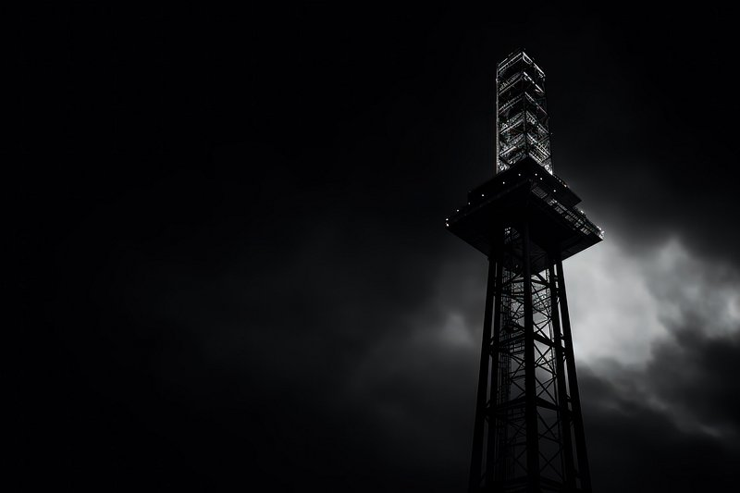

Why do customers leave, and can your business afford to let your customers slip away? Telecom Company Churn Rate
By: Daniel Shaw

Slide 2
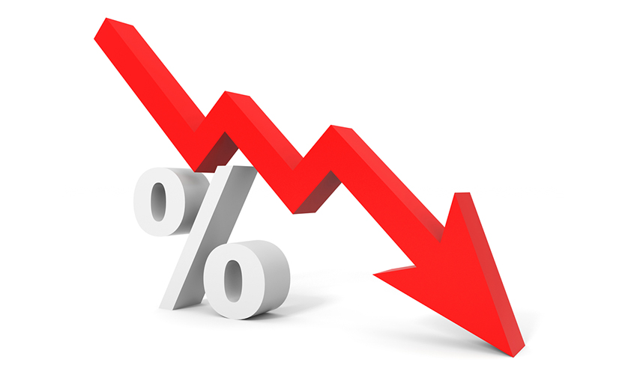
The Problem
A Switzerland mid-scale Telecom company Churn Rate is 26%.
Even though 26% is in the average, this company is trying to stand out for the field.
Churn increases costs to replace customers.
Direct negative impact on revenue.

Slide 3

Questions
Does pricing play a role in churn?
How should a Switzerland mid-scale wireless service company lower churn rate by the end of the year in order to
achieve at least 70% predictive accuracy in determining which customers will churn
(b) achieve a 10% decrease in churn rate?

Slide 4
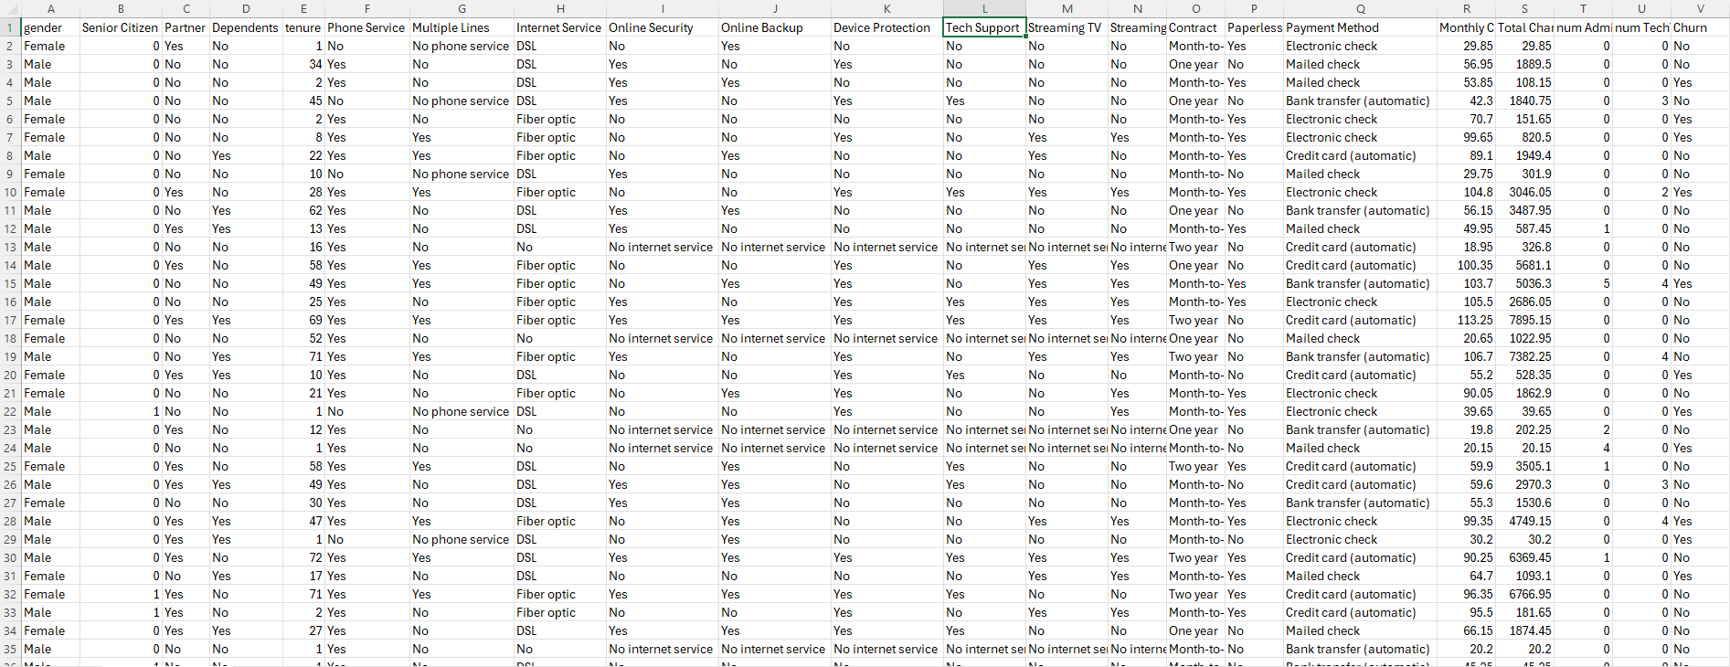
The Data
Source Data: https://www.kaggle.com/datasets/datazng/telecom-company-churn-rate-call-center-data/data

Slide 5
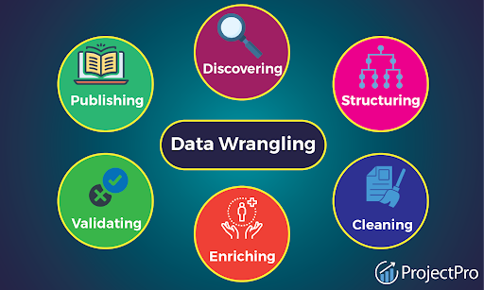
Data Wrangling
Data was collected from Jan 2021-Oct 2022
Raw dataset from Kaggle contained 7043 rows and 23 columns.
Clean data by searching for missing values and duplicates.
Replacing missing values with the statistical mean.

Slide 6
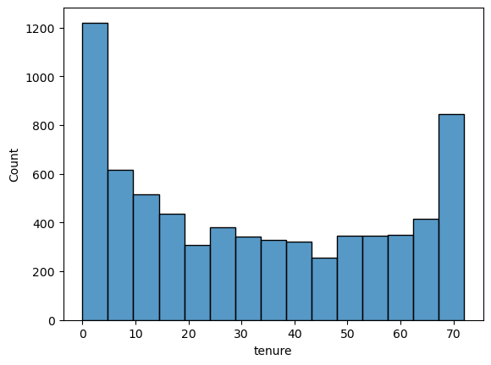
Exploratory Data Analysis (EDA)
The histogram indicates that most customers either leave in the 1st month or stay for more than 6 years.
The customers may stay longer because of the contract term.

Slide 7
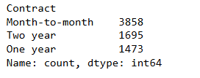
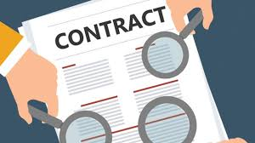

Exploratory Data Analysis (EDA)
Most customers decided to go with Month-to-month contracts.
Senior citizen represent 83% of custormers

Slide 8
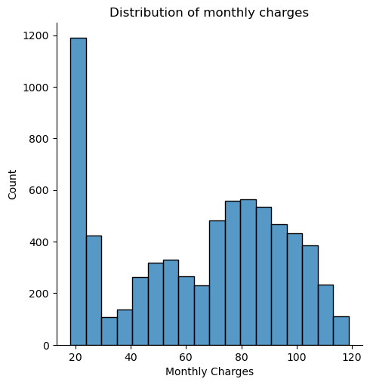
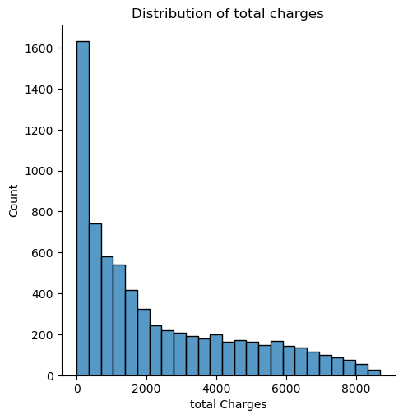
Exploratory Data Analysis (EDA)
Most consumers tend to purchase products priced around $19 or $20
As total charges increase, the count of consumers or transactions tends to decrease.

Slide 9
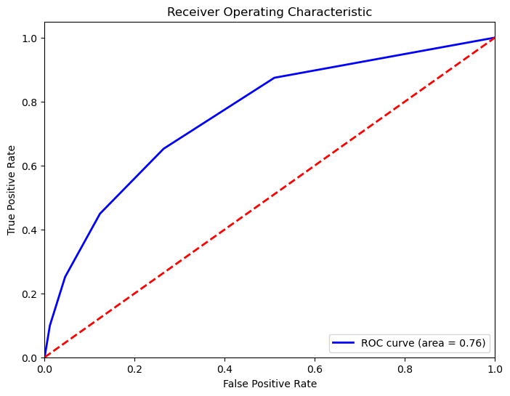
Modeling (K-nearest neighbor)
KNN performs particularly well on datasets with moderate sizes.
KNN is relatively simple to understand and implement.
The model achieved an accuracy of 76% on the test set.

Slide 10
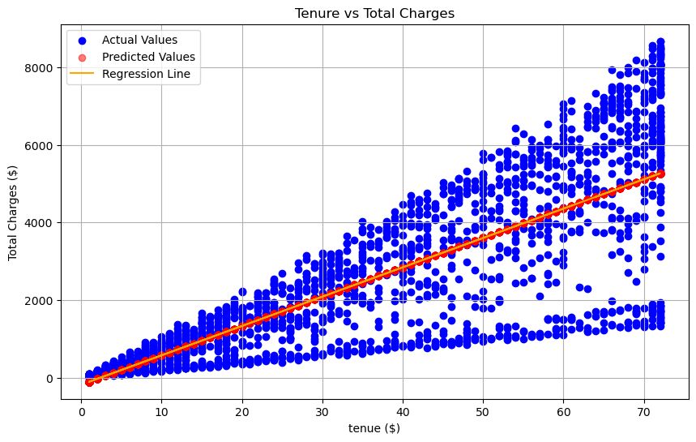

Modeling (Linear Regression)
Provides clear insights into the relationship between independent variables and the dependent variable.
Show a positive relationship between tenure and total charges.
1266.58 RMSE, suggests that the model's predictions have a relatively high error margin.

Slide 11
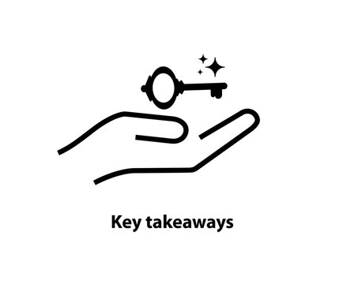
Takeaways
K-Nearest Neighbors (KNN) performed better, achieving a 76% accuracy.
Reached our 70% target margin.
High RMSE indicates there is room for improvement in the linear regression model's predictive performance.
churned customers appear to have a higher average spend than non-churned customers.

Slide 12

Recommendations
Apply new contracts prices that is responsible for at least 80% of our work request.
Marketing practices should be implemented for the senior citizens no later than January 2023.
Offer targeted loyalty programs and discounts to long-term customers.

Slide 13

Future Research
Refining the performance of both K-Nearest Neighbors (KNN) and Linear Regression to further improve churn prediction accuracy and overall model effectiveness.
Optimizing the number of neighbors (k)
Applying more advanced machine learning algorithms such as random forests or gradient boosting

Slide 14

Time to stop Churn!
Daniel Shaw

